Slide 1
Azure Marketplace and DataStax Enterprise
Ben.Lackey@DataStax.com
Partner Architect
+1 720 933 9852
@benofben

Slide 2
Agenda
Introduction
Lecture - Introduction to DataStax Enterprise
Lab 1 - Accessing the Cluster
Data Modeling
Lecture - Data Modeling
Lab 2 - CQL
Lab 3 - Primary Keys
Lab 4 - Consistency
Search
Lecture - Search
Lab 5 - Search
Analytics
Lecture - Analytics
Lab 6 – Analytics
Graph
Lecture - Graph
Lab 7 – Graph
Operations
Lecture - Operations
Lab 8 - Operations
Lecture - Wrap Up, Raffle and Next Steps

Slide 3



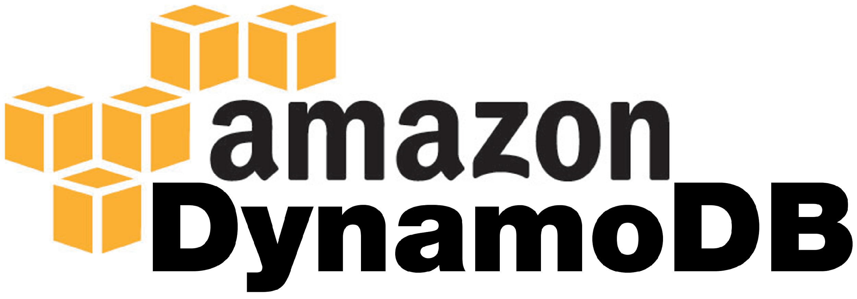
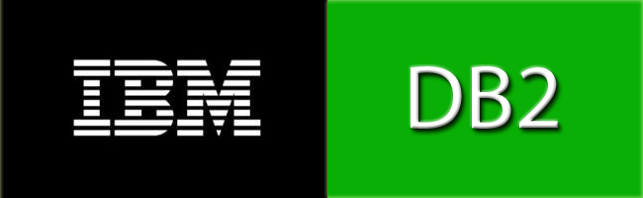







The New Database Market
Traditional Relational
Post Relational
Transactional
Analytical

Slide 4
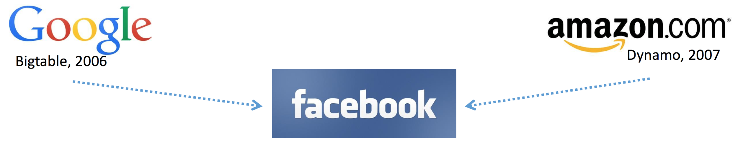


Where does Cassandra come from?
Schema
Memtables
Compaction
SStables
Commit Log
Cluster Architecture
Partitioning
Replication
Gossip
Anti-Entropy
Hints

Slide 5
Apache Cassandra
Distributed self healing mesh
No active/passive
Peer to peer replication
No single point of failure
Writes are done to all nodes simultaneously
Data is safe from node, rack, and datacenter failure
Optimized for high volume, low latency operations

Slide 6
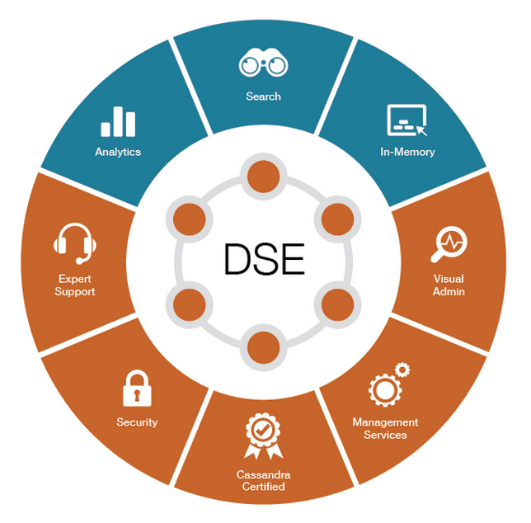
DataStax Enterprise

Slide 7
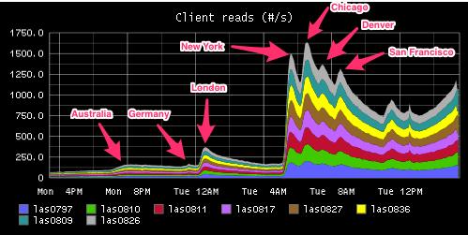

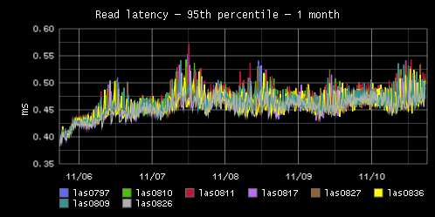
DataStax Enterprise
Always On
Active/Active Distributed

Slide 8
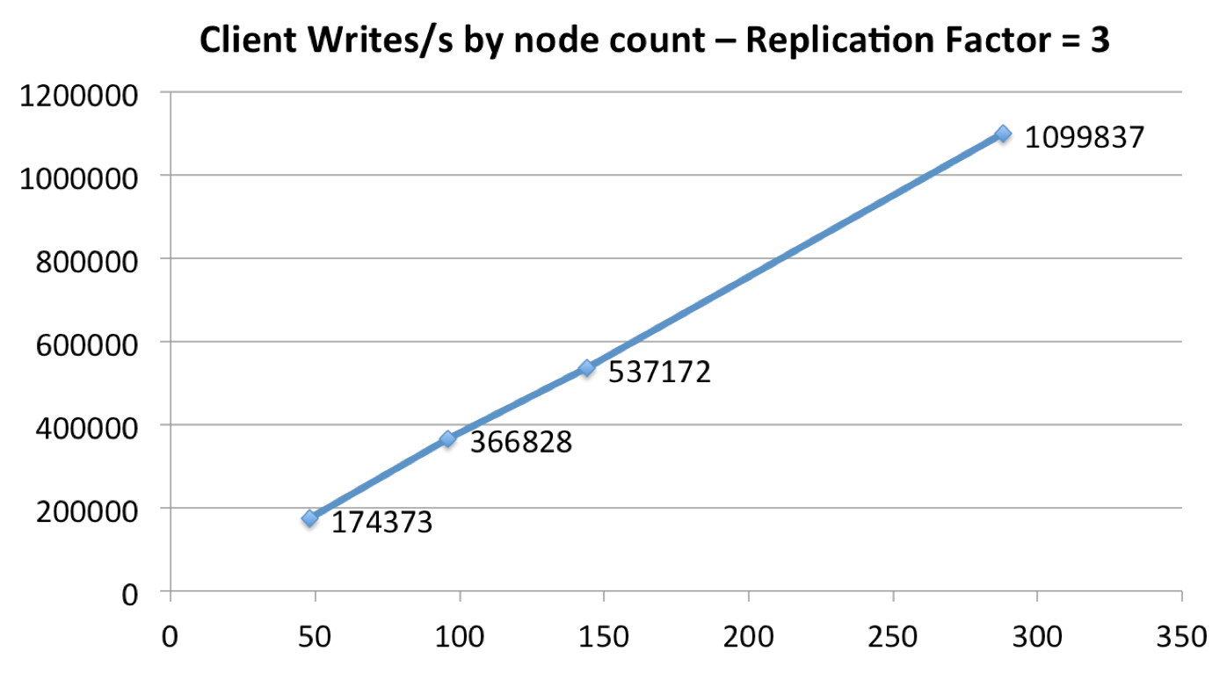
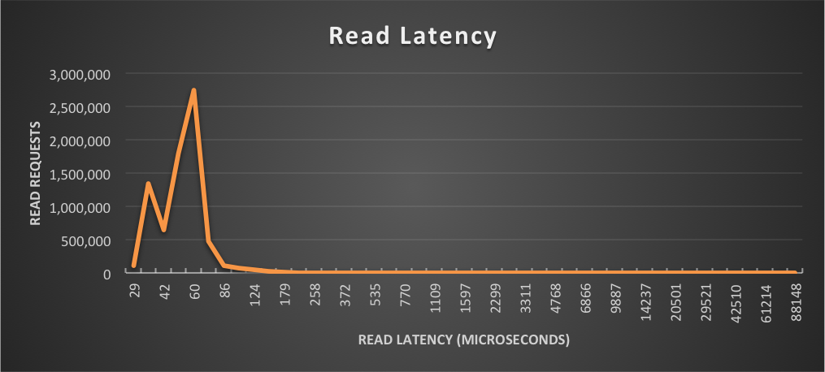
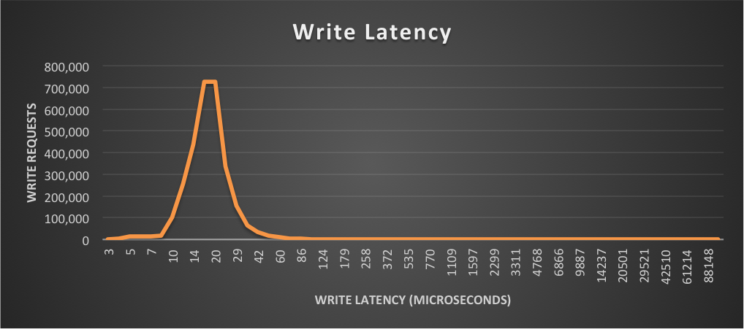
DataStax Enterprise
Fast (Low Latency)
Huge Linear Scale

Slide 9





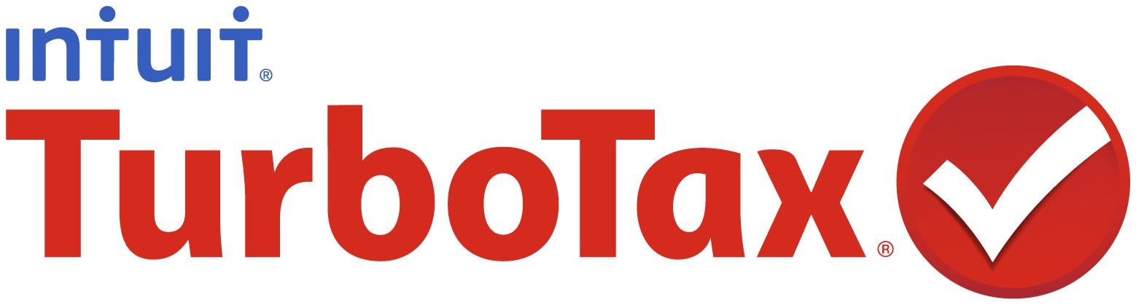
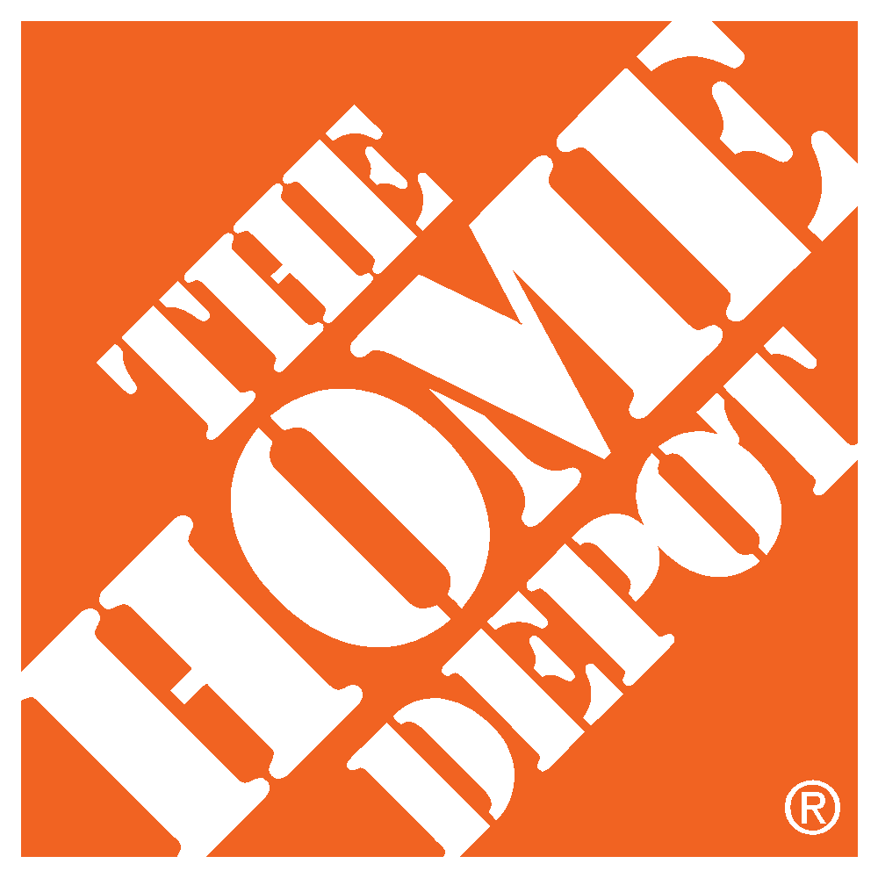



















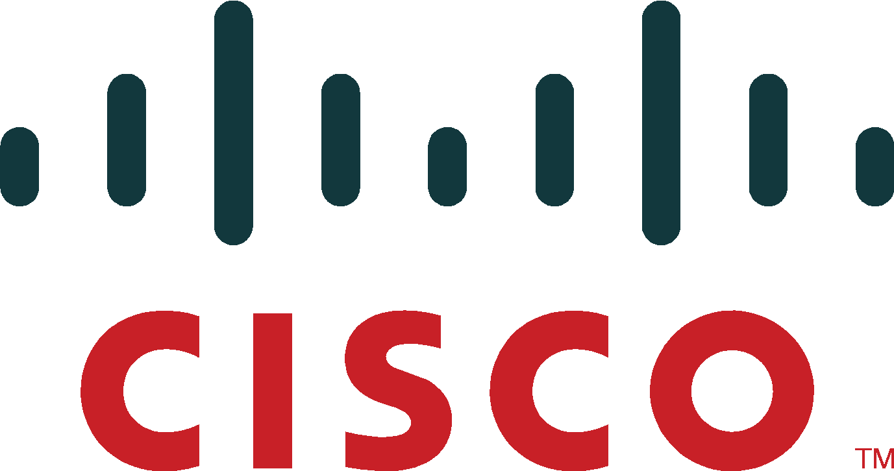










DataStax Use Cases
MDM: Customer 360, Product Catalog
Personalization and Recommendation
Internet of Things (IoT) and Time Series
Fraud Detection
List Management
Messaging
Inventory Management
Authentication

Slide 10
Lab 1 – Accessing the Cluster
https://github.com/DSPN/DataStaxDay
Note, if you don’t have a cluster, start at Lab 0.

